Slide 1


SOUNDING ROCKET ALLOWABLE
DIFFERENTIAL PRESSURE
Ashlee Espinoza, Berton Vite, and Raul Rios
California State University, Long Beach
AIAA Region VI Student Conference
Seattle, WA
March 31, 2012

Slide 2
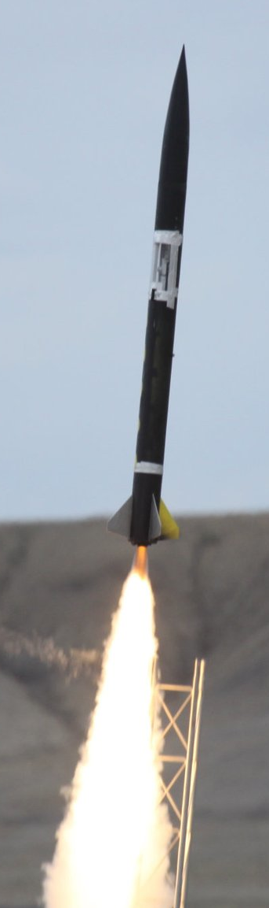
Topic Outline
Introduction
Problem
Solution
Summary

Slide 3
Background
Experimental Sounding Rocket Association, Intercollegiate Rocket Engineering Competition
Failure to reach predicted apogee for 3 competitions
In the 2011 competition, the payload window/door detached from the rocket during flight and was recovered approximately 500-700 feet from the launch site (the main rocket body was recovered 1.5 miles down range)
Notes:
ESRA Competition
Failure to come close to predicted apogee
Focus on excessive drag
Door found near launch site, due to excessive internal pressure

Slide 4
Failure Mode
Failure analysis examined thrust, weight and drag to explain the apogee short fall
    Weight was measured on a scale
    Thrust was established by static firings
    Excessive drag due to an open cavity was only realistic cause
Why did the door come off?
    The door was not affected by any bending load, which was carried primarily by the longerons
    Skin friction drag was also not a possible explanation
  Venting analysis showed significant door differential pressure around burnout
  The door came off because inadequate venting caused excessive internal pressure
Notes:
Failure mode sketch from RST memo, failure theory from RST memo
Put in failure criterion equation from RST memo

Slide 5
Peeling Failure Mode
Peeling Failure
Duct Tape
Door
Rocket Skin
Excessive Internal Pressure

Slide 6
Venting Simulation
BLOWDOWN.xls: A 4th order Runge-Kutta method that numerically integrates to obtain pressure inside a cavity as a function of vent hole size
Trapped air expands isentropically, and very quickly
    No time for heat transfer from cavity to the air
Inputs: trajectory altitude, velocity, orifice coefficients (incompressible and sonic throat), and external pressure coefficient at the vent exit as a function of Mach number
    Subsonic orifice coefficient developed from a Busemann Approximation
Differential pressure is external pressure subtracted from cavity pressure
    External pressure determined by trajectory data
Notes:
BLOWDOWN code on RST website
Single vent hole, single cavity, isentropic cavity expansion, 4th order runge kutta integration
Generates maximum diff pressure as f (vent hole size)
Venting word doc that describes the code (pull out key bullets)
Delta p calculation?

Slide 7
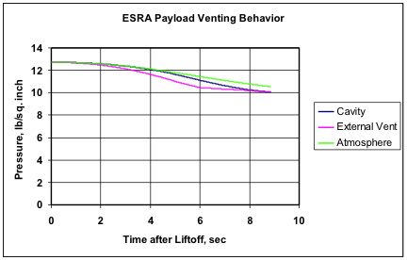
Venting Behavior
Notes:
External: as the air comes around the body it won’t stay at atm, speeds up slows down.

Slide 8
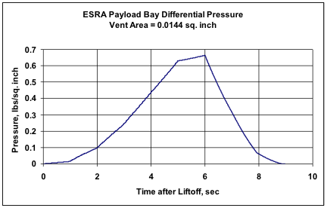
Differential Pressure
Burn out

Slide 9
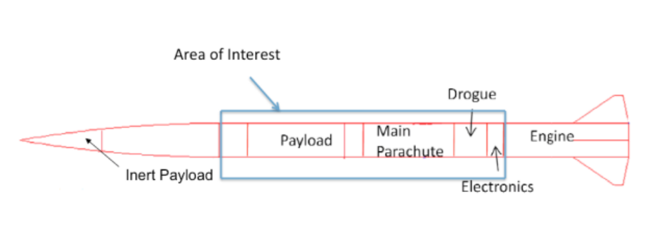
Testing Apparatus
Material: Cardboard Mailer Tube
Length: 4 ft.
Two Doors
    12 in. x 5.19 in.
    11.88 in. x 4.25 in.
Plastic end caps to seal it shut
Notes:
Labeled photo from paper.
Close ups of the enclosures and gauges.

Slide 10
Apparatus continued…
Presta valve attached to the mailer tube and a bike pump was used to pressurize the article
    The gauge on the bicycle pump was used to measure the pressure
After an attempt to pressurize the tube it became apparent that air was escaping
    Escaping through the spiral seams
    Slow pressurization contributed
Next logical step was to seal the seams
    Plumber’s caulk applied on main tube and doors

Slide 11
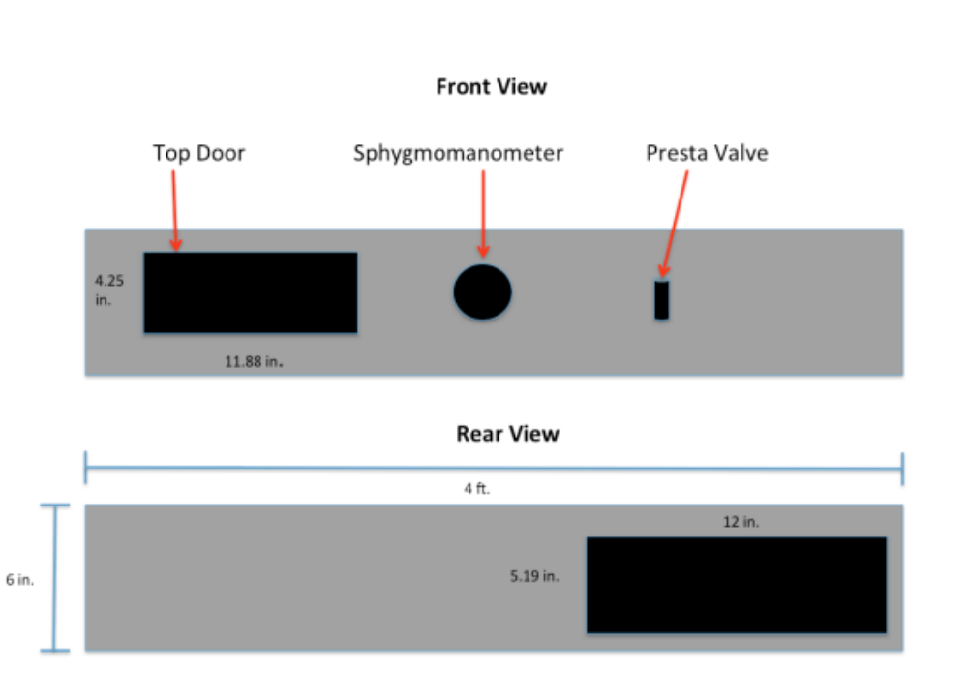
Apparatus continued…
Bike pump gauge
    Gauge on the bike pump supplied inconclusive results.
    Not accurate enough to measure small pressure
Sphygmomanometer gauge
    Used to measure blood pressure in mm of Hg
    Measures very small pressures with much better accuracy (±2 mm of Hg)
Top View
Top Door
Sphygmomanometer
Presta Valve
Bottom View

Slide 12
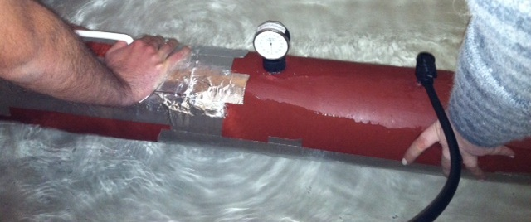
Apparatus continued…
In preparation for performing the actual experiment:
    Lithium grease applied to the edges of the doors
    Doors were attached using aluminum tape applied in a 3 layer schematic
Mailer Tube (sealed)
Aluminum Tape
Sphygmomanometer Pressure Gauge
Bicycle Tire
Presta Valve

Slide 13
Experimental Procedures
Checked for leaks in the apparatus by submerging it in water without adding any pressure.
Applied pressure to the apparatus until the weaker of the two doors failed.
Recorded pressure when the weaker door began to fail.
Notes:
Explain the actual experment: checking the apparatus in the water, adding puressure, and recoreding the shygonmeter.

Slide 14

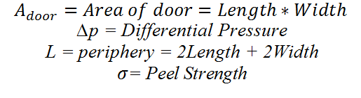
Test Data
Weakest door
    Area 50.47in Sq.
    Periphery 32.25 in
Results
    Failure at 10 mmHg ≈ 0.2 psi
    At this point the pressure could no longer be increased.
Taped door peel strength .3 lb/in
Notes:
We found that a peel load of about 0.3 lb/in is the most that taped-on doors can hold. It is recommended that a peel load of 0.2 lb/in be used to size the venting holes.

Slide 15
Summary
Conclusion
    Calculation with BLOWDOWN.xls estimated the maximum differential pressure during flight to be approximately 0.65 psi. The experimental results are consistent with flight experience.
Recommendations
    For doors/windows, that are not intended to separate in flight (i.e. payload sensor windows), taping all the way around the rocket. The tape will experience a tensile load, not shearing.
    For doors that must be separated in flight (i.e. hatches over parachutes), select compartment vent size that ensures tape shearing load will be less than 0.2 lb/in.
Acknowledgments
    Thank you Mr. Charles Hoult, Dr. Janet Hoult, and Vanessa Gonzalez
Notes:
Rec-do a careful design on the doors with lots of periphery and less door area (circular door) detlap~l/adoor; instead of taping just at edge, tape around the entire rocket;design vent hole size using blowdown to get the deltap underneath the criterion;
Talk to you in july on how well this worked.

Slide 16
Questions?

